Slide 1
Nanostructured Materials lecture-3
Introduction to Synthesis approaches of Nanomaterials
Dr. Suha I. Al- Nassar

Slide 2
Synthesis Approaches of Nanomaterials
There are two opposite, approaches mechanism to synthesis nanomaterials, Top-down approach and Bottom-up approach, both these two approaches play very important roles in nanomaterials properties depending on their size, shape, and chemical composition.
1`- Bottom-up approaches seek to have smaller components built up into more complex assemblies, while top-down approaches seek to create nanoscale devices by using larger, externally controlled ones to direct their assembly.
2- The top-down approach often uses the traditional workshop or microfabrication methods where externally controlled tools are used to cut, mill, and shape materials into the desired shape and order

Slide 3
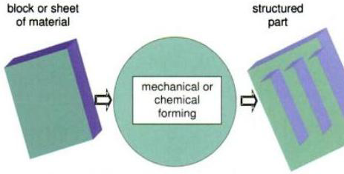
Nanoparticle synthesis techniques
Top-down processes:
-In this method material is removed from the bulk material, leaving only the desired nanostructures
-Used to manufacture conventional products
-Newly developed techniques allow for much smaller sizes (close to 1μm)
-Processes include: Milling, Grinding, Electron beam machining ,laser ablation
-Examples of products: Traditional furniture, car chassis, etc.

Slide 4
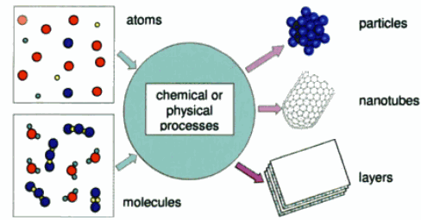
Nanoparticle synthesis techniques
Bottom-up Process:
- In this method one where the atoms produced from reduction of ions, are assembled to generate nanostructures
-Uses atoms and molecules as building blocks of structures
-Focus of Nano technological manufacturing processes
-Examples: Chemical synthesis processes

Slide 5
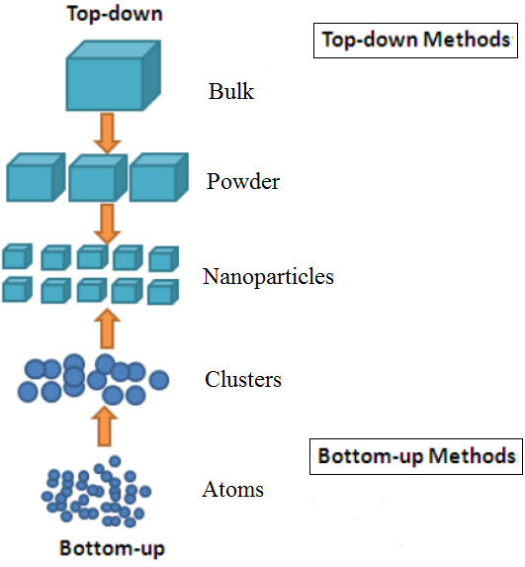
Bottom-up or top-down?
a. Top-down: size reduction from bulk materials.
b. Bottom-up: material synthesis from atomic level.

Slide 6
  Top-Down Approach (Dispersion Method)
    1- Mechanical synthetic Methods :-
Mechanical methods offer the least expensive ways to produce nanomaterials in bulk. Ball milling is perhaps the simplest of them all. Ball milling produces nanomaterials by mechanical attrition in which kinetic energy from a grinding medium is transferred to a material undergoing reduction. Compaction and consolidation is an industrial scale process wherein nanomaterials are "put back together" to form materials with enhanced properties. Metallic alloys can be made this way. Many top-down mechanical methods are utilized by industry.

Slide 7
2- Laser ablation
Is the process of removing material from a solid surface by irradiating it with a laser beam. It has shown itself as one of the most efficient physical methods for nanofabrication.
Liquid
Vacuum
occur in
Gas

Slide 8
The most efficient physical method for nanofabrication is the laser ablation technique because of a number of advantages compared to conventional methods, the advantages of laser ablation method are
simplicity of the procedure and the absence of chemical reagents in solution .
This method also gives certain flexibility over other techniques as all types of materials can be processed and ablated due to the very high energy density.
Controlling the size of produced NPs by optimizing the process parameters such as laser irradiation time, pulse duration, energy density, laser wavelength...etc.

Slide 9
Mechanisms of Laser Ablation
The interaction of laser light with matter lead to generation of high temperature and high pressure
Plasma formation
the plasma expands and will quench quickly after one pulse due to ultrasonic and adiabatic expansion of the plasma plume.
Plasma expanding
The species in the plume colloid and react with the molecules of the surrounding liquid and this leads to produce new compound NPs .
Production of fine particles

Slide 10
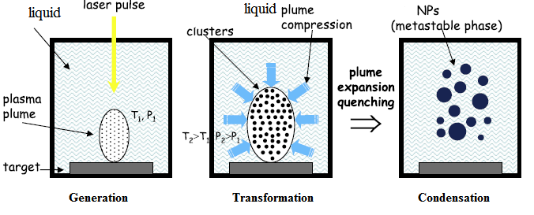
Therefore there are three basic processes of the plasma plume from laser ablation of solids. These processes are generation, transformation, and condensation, which play important roles in materials preparation. Figure 2, shows a schematic diagram of the physical mechanism of formation NPs .
(a)
(b)
(c)
Figure 1.2: A schematic diagram of the physical mechanism of formation NPs,
a- Generation process, b- Transformation process and c - Condensation process

Slide 11
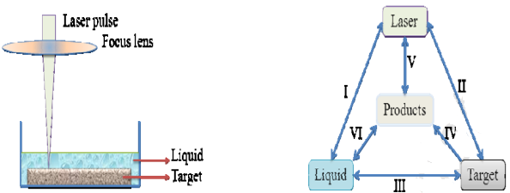
The below figure shows the general schematic diagram of a typical experimental setup for PLAL. The setup basically only needs pulsed laser beam delivery optics and a container to hold the target and liquid. The container as well as the target is usually rotating by using magnetic stirrer or rotating stage

Slide 12
2- Arc Discharge Method
Fabrication of nanoparticles using arc discharge method has gained much interests due to its simplicity in apparatus set up and ability to scale up the production rate of nanoparticles . One of the most widely reported nanoparticles synthesized using this method is carbon nanotubes (CNTs) using the direct current (DC) arc. Arc discharge involves very simple setups with two electrodes acting as cathode and anode respectively. These electrodes are subjected to a potential and subsequently cause an electrical breakdown. Arc discharge generally requires low voltage (few to several tens of V) and high current density (105–1011 A/m²). Synthesis of nanoparticles using arc discharge method can be either in pulsed or continuous mode. To produce MWNTs and SWNTs, high purity graphite are used as electrodes and arc discharge can be carried out in helium or hydrogen gas discharge

Slide 13
Figure 4 showed a schematic illustration of the experimental set up for the arc discharge. During the arc discharge, electrons are emitted either through heating or field emission due to large electric field generated. Plasma is thus formed due to the ionization and this exerts large amount of heat, which subsequently evaporate the A metal of interest into metal vapor. The plasma also enhances the kinetics of the chemical reactions, dissociating atoms and radicals. The metal vapor later nucleates and forms nanoparticles in the surrounding cooling medium The metal vapour can either be quenched by mixing with cold gas or by the surrounding liquid medium.

Slide 14
Bottom-Up Approach (Reduction Method):
1. Hydrothermal Synthesis
Hydrothermal method is a simple and versatile method for the synthesis of inorganic nanomaterials under high temperature and high-pressure condition. It is possible to alter the characteristic of the nanoparticles by adjusting processing conditions including temperature, pressure or precursor concentration. The density of water and dielectric constant are highly dependent on the temperature and pressure.
Hydrothermal synthesis is typically carried out in a pressurized vessel called an autoclave with the reaction in aqueous solution. The temperature in the autoclave can be raised above the boiling point of water, reaching the pressure of vapour saturation. Hydrothermal synthesis is widely used for the preparation of TiO₂ nanoparticles which can easily be obtained through hydrothermal treatment of peptized precipitates of a titanium precursor with water

Slide 15
2. Gas Phase Methods
Gas phase methods are ideal for the production of thin films. Gas phase can be carried out chemically or physically. Chemical Vapour Deposition (CVD) is a widely used industrial technique that can coat large areas in a short space of time. This process is often used in the semiconductor industry to produce high-purity, high-performance thin films. In a typical CVD process, the substrate is exposed to volatile precursors, which react and/or decompose on the substrate surface to produce the desired film. Frequently, volatile by products that are produced are removed by gas flow through the reaction chamber. The quality of the deposited materials strongly depends on the reaction temperature, the reaction rate, and the concentration of the precursorsl. The advantages of this method include the uniform coating of the nanoparticles or nano film. However, this process has limitations including the higher temperatures required, and it is difficult to scaleup .

Slide 16
Physical vapour deposition (PVD) is another thin film deposition technique. Films are formed from the gas phase but without a chemical transition from precursor to product. For TiO₂ thin films, a focused beam of electrons heats the titanium dioxide material. The electrons are produced from a tungsten wire heated by a current. This is known as Electron beam (E-beam) evaporation. Titanium dioxide films deposited with E-beam evaporation have superior characteristics over CVD grown films such as, smoothness, conductivity, presence of contaminations and crystallinity.

Slide 17
3. Conventional Sol-Gel Method
Similar with the chemical precipitation and hydrothermal method, sol gel synthesis takes place in an inexpensive reactors, allow precise stoichiometry control and thenanoparticles synthesized are generally having smaller particles size and narrow size distribution.The sol-gel method is a versatile process used for synthesizing various oxide materials .This synthetic method generally allows control of the texture, the chemical, and the morphological properties of the solid. This method also has several advantages over other methods, such as allowing impregnation or coprecipitation, which can be used to introduce dopants. The major advantages of the sol-gel technique includes molecular scale mixing, high purity of the precursors, and homogeneity of the sol-gel products with a high purity of physical, morphological, and chemical properties. A Sol- gel is not static during aging but can continue to undergo hydrolysis and condensation .

